Slide 1


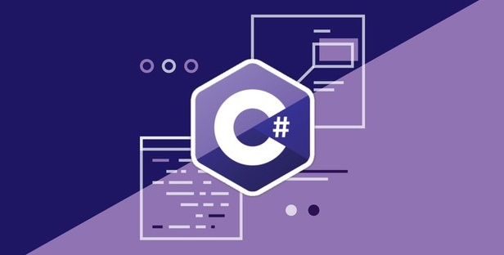
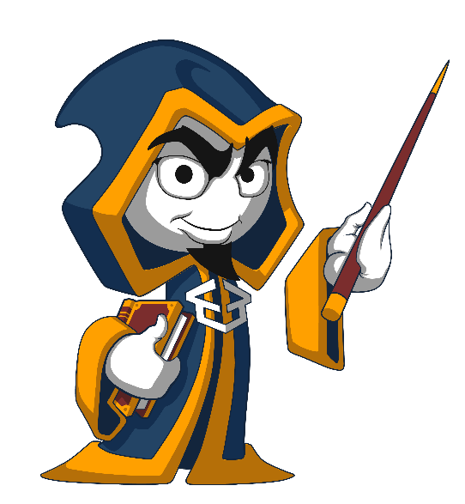
Programming Fundamentals Extended
Course Introduction
Programming Fundamentals
SoftUni Team
Technical Trainers
Software University
http://softuni.bg

Slide 2

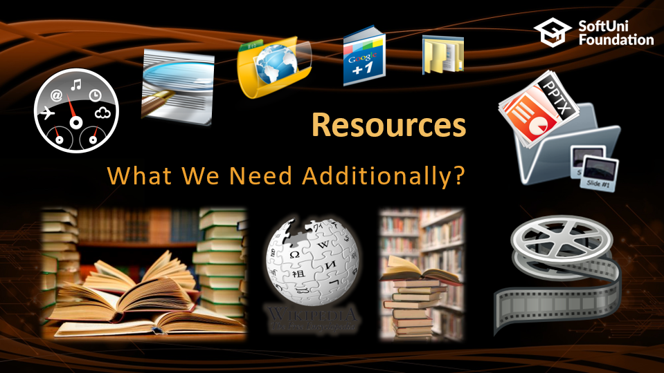
Table of Contents

Slide 3
Questions
sli.do #fund-softuni

Slide 4

Programming Fundamentals
Course Objectives & Program

Slide 5


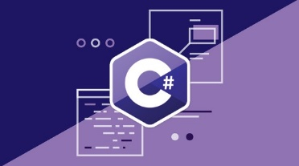
Progr. Fund. Extended – Course Program
Course Introduction – Course Program, Trainers, Exams, Resources
Data Types, Variables and Methods: Data Types & Variables
Arrays, Lists, Array and List Algorithms: Arrays and Lists Algorithms
Strings, Regular Expressions and Text Processing: Manual and Regex Text Processing
Dictionaries, Nested Collections, LINQ and Lambda Expressions: Dictionaries, Nested Dictionaries, Lists and Collections, Manipulations with LINQ
Exam Preparation: Practical Exam Problems (2 times)
Practical Exam: 4 problems

Slide 6

Programming Fundamentals: More Details
Duration, Languages, Technologies

Slide 7


Training Duration – Programming Fundamentals
Lessons: ~30 hours (onsite + videos)
Practical exercises (in class): ~40 hours
Exam preparation: 2*4 hours
Exam: 6 hours
Schedule: November – December 2017
Exam date: 10 December 2017

Slide 8



Why English?
Why are the slides in English?
English is the native language of the software engineers
Specific terminology should be in English
Translations are inaccurate and funny
Just learn English!
No excuses

Slide 9



Learn to Search in Internet & Find Solutions!
The course assignments require to search in Internet
This is an important part of the learning process
Some exercises intentionally have no hints
Learn to find solutions!
Software development includes everyday searching and learning
No excuses, just learn to study!
Developers learn new technologies, tools, languages every day!

Slide 10

Evaluation

Slide 11
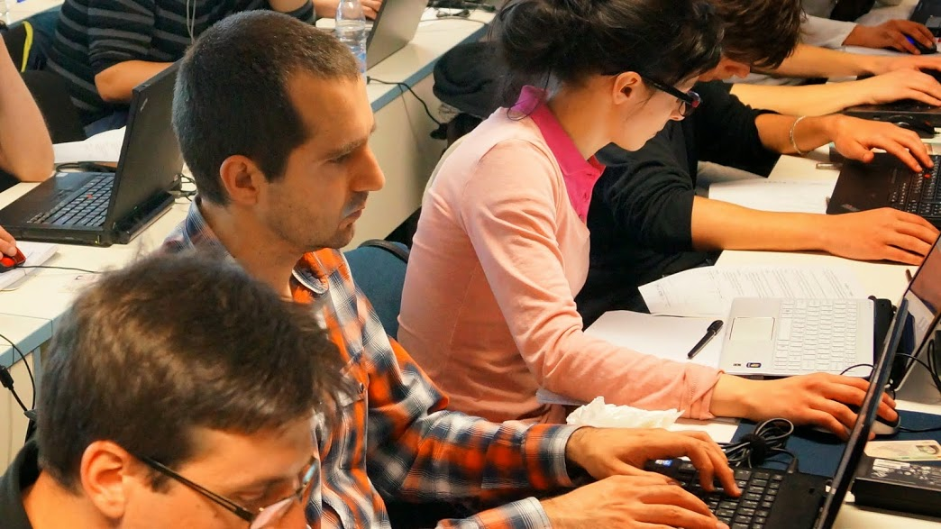


Programming Fundamentals
Evaluation Criteria

Slide 12


Scoring System for “Programming Fundamentals”
Exam – 90%
Homework (exercises) – 10%
Bonuses: up to 10%
Presence in class: 5% (onsite students only)
Forum activities
Others

Slide 13
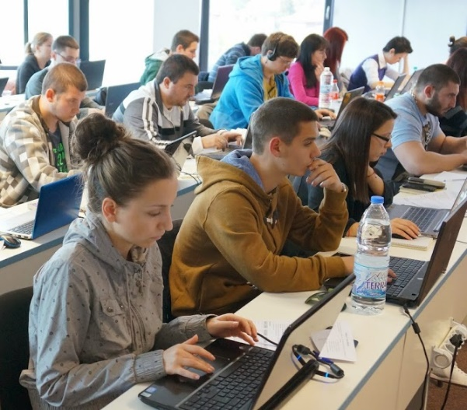

Programming Fundamentals Exam
Practical programming exam
4 practical problems for 6 hours
Simple arrays, lists, dictionaries, strings
Code in C# (Java, PHP, JS are also welcome)
Automated judge system
http://judge.softuni.bg
Solutions are evaluated for correctness only
Code quality is still not measured

Slide 14

Homework Assignments
Doing your homework is very important!
Programming can only be learned through a lot of practice!
You should write code every day!
Each lesson is followed by many exercises
Try to solve them in class
The rest are your homework
Homework assignments are due in 6 days after each lecture
Submission through our online judge system: judge.softuni.bg

Slide 15










Resources
What We Need Additionally?

Slide 16



PF Course Web Site, Forum and FB Group
Official web site:
Official discussion forum:
Official Facebook groups:
https://softuni.bg/courses/programming-fundamentals
https://softuni.bg/forum/categories/44/programming-fundamentals
https://www.facebook.com/groups/tech.module.sept.2017

Slide 17

The Prog. Fundamentals Slides and Videos
All lecture slides, videos, homework assignments, projects and other resources are open content, available for free
Visit the course web site to access the course resources

Slide 18
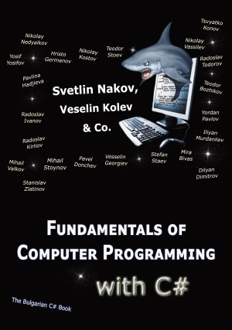

The Free C# Fundamentals Textbook
Partial textbook for the course:
"Fundamentals of Computer Programming with C#", by Svetlin Nakov & Co., 2013, ISBN 9789544007737
English and Bulgarian versions (as PDF, ePub, …)
Freely downloadable from: www.introprogramming.info
The C# Programming courses @ SoftUni.bg partially follows the book
Programming Fundamentals → chapters 2, 3, 7, 9, 11, 13, 14, 16, 18, 22

Slide 19

Software University Learning System (SULS)
Software University Learning System (SULS)
www.softuni.bg
Important resource for students
Homework submissions
Homework check-up
Exams and results
Reports about your progress
…

Slide 20


Required Software
Software needed for this course:
Microsoft Windows (Win 10 / 8.1 / Win8 / Win7) or Mac or Linux
Visual Studio Community 2017 (a free version of VS 2017)
Older versions are acceptable, but not recommended
Alternative: MonoDevelop (for Linux / old Windows)

Slide 21




Summary
Training program
Data types, methods, debugging, arrays and lists, dictionaries, objects, strings and much more
Practical exam
4 problems for 6 hours
Learning resources
Slides, videos, software, books, forum

Slide 22







Progr. Fund. Extended – Course Overview
https://softuni.bg/courses/programming-fundamentals

Slide 23
License
This course (slides, examples, demos, videos, homework, etc.) is licensed under the "Creative Commons Attribution-NonCommercial-ShareAlike 4.0 International" license

Slide 24





Trainings @ Software University (SoftUni)
Software University – High-Quality Education, Profession and Job for Software Developers
softuni.bg
Software University Foundation
http://softuni.foundation/
Software University @ Facebook
facebook.com/SoftwareUniversity
Software University Forums
forum.softuni.bg

